Slide 1


VIDEO GAMES SALES ANALYSIS
GROUP 4
CASSANDRA BROWN | BRENDEN MERTZ | JWETA PATEL | RAFAEL QUINTERO | DIANA VILLARREAL
Notes:
Jweta

Slide 2
OVERVIEW
Selected topic
Reason the topic was selected
Description of the source of data
Questions the team hopes to answer with the data
Description of the data exploration phase of the project
Description of the analysis phase of the project
Technologies, languages, tools, and algorithms used throughout the project
Result of analysis
Recommendation for future analysis
Anything the team would have done differently
Notes:
Jweta

Slide 3
SELECTED TOPIC
01
We will be laying the foundation for our analysis by processing and exploring a large amount of data on video game sales. The dataset contains information regarding the sales of video games across various regions like North America, Europe, Japan and also globally, while also giving information regarding the Names, Publishers and Platforms.
Notes:
Jweta

Slide 4
REASONS THE TOPIC
WAS SELECTED
02
The world is getting more connected every day, and more gaming trends and preferences are emerging around the globe.
We want to know which console is preferred the most based on different regions.
We will compile results from all over the world and determine if any regional trends might shape the gaming industry as a whole.
It's great stress relief and some games are just so much fun to play , Enjoyment for all age people.
Notes:
Jweta

Slide 5

Description of the Source Data
03
The datasets we used are from Kaggle which is the home for many datasets and competitions.
Our data is comprised from four different data sets found on Kaggle. These datasets have video game titles, genres, console types, of games sold, dates, and region it sold in.
Notes:
Jweta

Slide 6
Questions We Hope to Answer with the Data
04
What genre of game sells best?
What years do games sell the best?
What region games sell the best?
Overall comparisons between genre, console types, dates sold, and regions sold in?
Notes:
Jweta

Slide 7

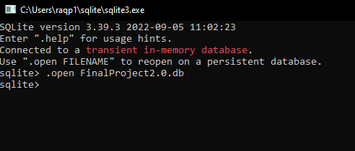
Database
05
SQLITE database was created
Notes:
Rafa

Slide 8
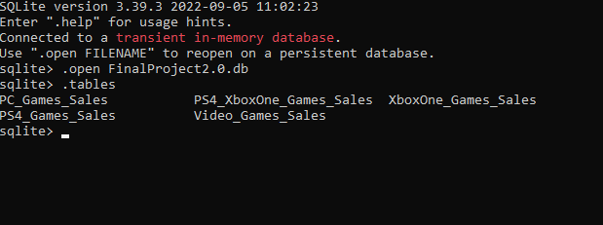
Datasets were uploaded to database and were joined into one
05
Notes:
Rafa

Slide 9
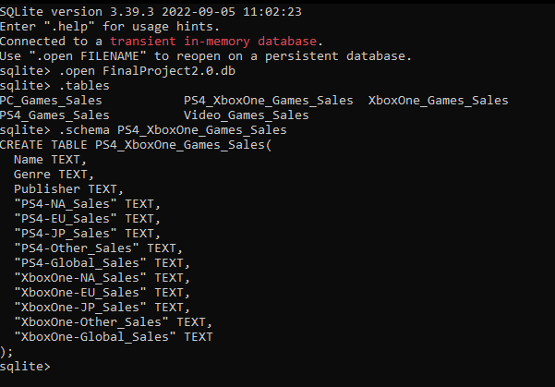
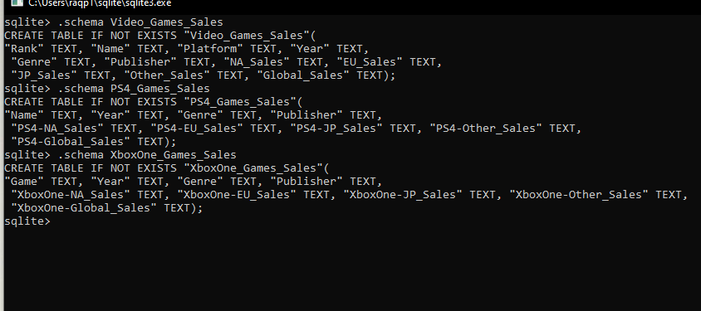
05
Notes:
Rafa

Slide 10
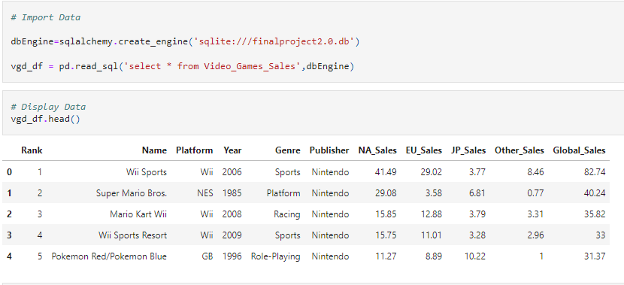
05
Database is connected to model via SQLAlchemy
Notes:
Rafa

Slide 11


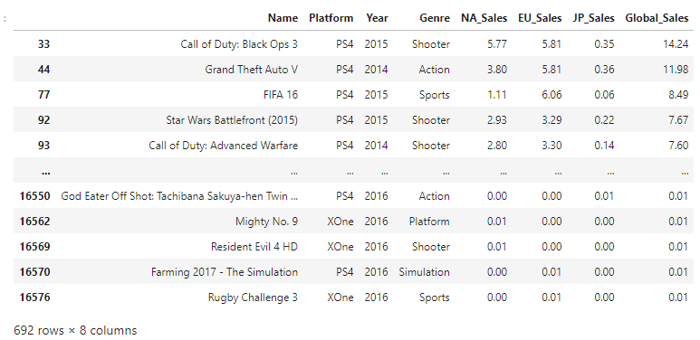
05
We filtered the datasets to get only the consoles we needed
Notes:
Rafa

Slide 12
ANALYSIS PHASE
06
The analysis phase will be demonstrated via the Tableau Visualization and python which will chart game sales over time and will be filterable by game genre, console type, and region. We will be able to predict sales trends on each as well as review historical data.
For Example:
Does a relationship exist between the variables
We can see that sales have been continually increasing over time.
North America has been the leader in video game sales for the most part, however, Japan looks like it was able to surpass North America briefly between 1992 and 1996.
Notes:
Cassandra

Slide 13
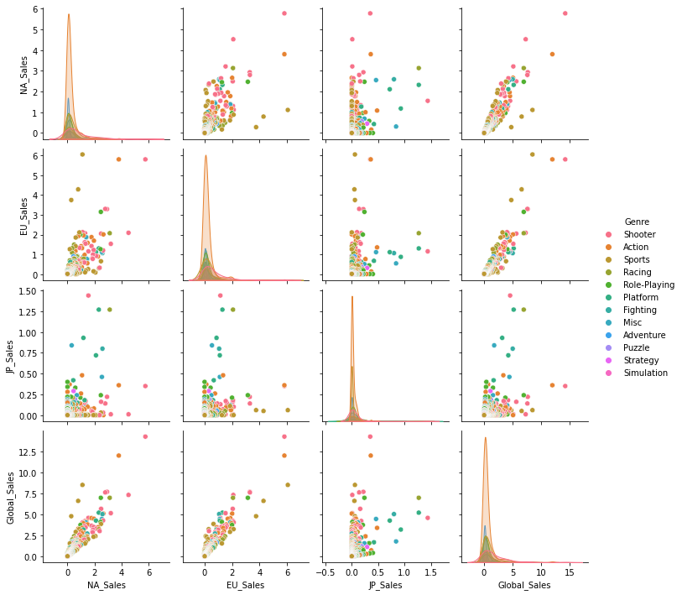
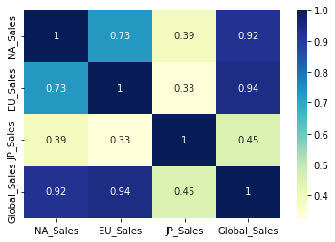
06
The above graphs demonstrate that there is a relationship between genre and sales, that also exhibits linearity.

Slide 14
TECHNOLOGIES, LANGUAGES, TOOLS, & ALGORITHMS USED
JUPYTER NOTEBOOK
MODEL TRAINED & SPLIT
DUMMY VARIABLES
Repeated for each Region
07
ASSIGNED TO GENRE CATEGORIES TO GIVE THEM NUMERICAL VALUE
MAP & COEFFICIENT GENERATE FOR EACH COUNTRY
SIMPLE LINEAR REGRESSION IN PYTHON TO MODEL PREDICTED SALES BY GENRE
Train_size = 0.7
Test_size = 0.3
Random_state = 100
Notes:
Cassandra
Discuss the training and how it was consistent. Why regression was chosen and the dummy variables
Jupyter notebooks was used to perform a simple linear regression in python to model predicted sales by genre.
Dummy variables were assigned to the genre categories to give them a numerical value.
The model was trained and split using :
train_size = 0.7, test_size = 0.3, random_state = 100
This was repeated for the four regions with a map and coefficient generated for each country.
The each model was trained using the same method to keep consistent.

Slide 15
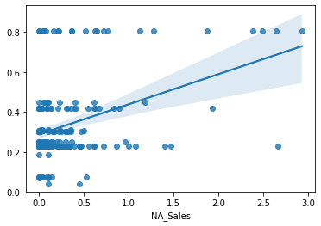
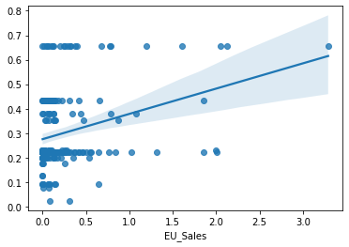
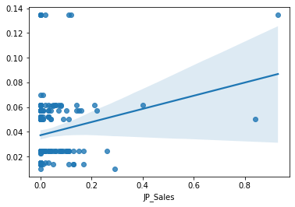
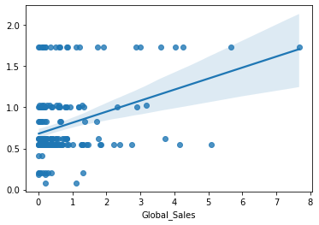
RESULTS
08
North America
Europe
Japan
Other Countries
Notes:
Cassandra
Linear regression line, explain it
x= sales by country
y = genre

Slide 16
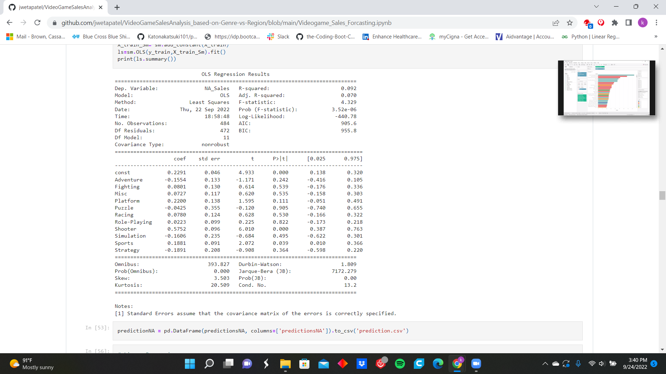
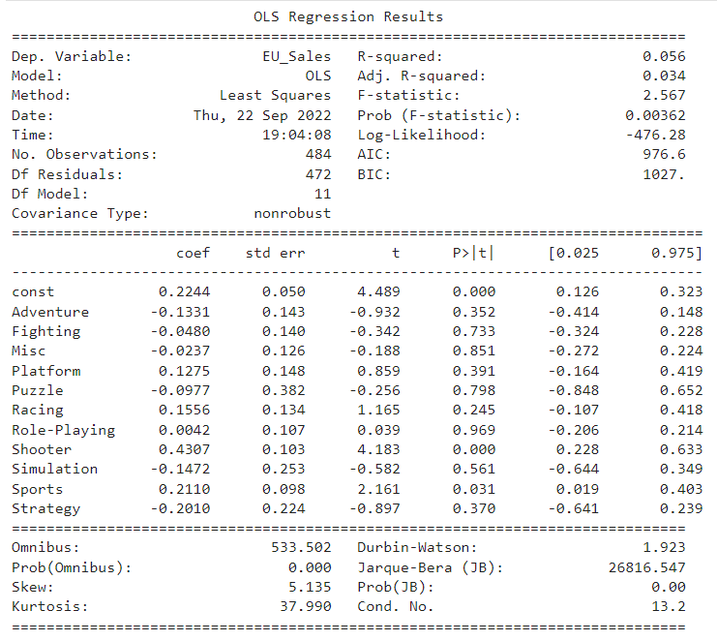
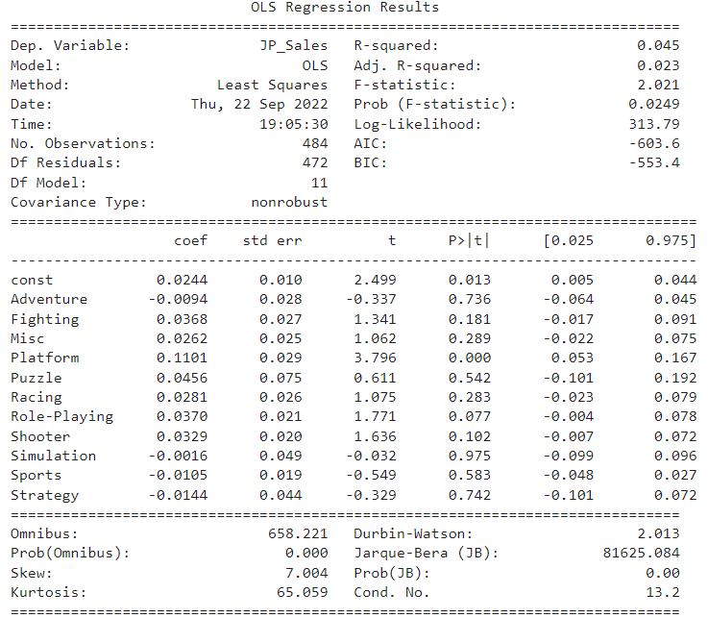
RESULTS CONT’D
08
Notes:
Cassandra
-discuss the accuracy, coefficients, and p value. Statistical significance, and why the values were not changed.

Slide 17


DASHBOARD
08
LINK 1
LINK 2
LINK 3
LINK 4
Notes:
Diana First 3 Dashboards
Brenden Last Dashboard

Slide 18
RECOMMENDATIONS FOR FUTURE ANALYSIS
09
Adding a population metric for each region to present the data in percentages for better comparison.
Adding more console types from eighth and ninth generations, such as the Nintendo Switch, PS5, Xbox One Series X, etc.
Notes:
Brenden
Population metrics can allow for percentages and more accurate comparisons between regions/genres
Newer consoles/Newer data = more recent trend patterns that may be developing.

Slide 19

THINGS WE WOULD HAVE DONE DIFFERENTLY
10
Used geographical data rather than listed regions.
Used purely country data rather than Japan vs Europe vs NA.
  China. 50.18B. 742.19M.
  United States. 47.62B. 197.16M.
  Japan. 22.01B. 78.1M.
  South Korea. 8.48B. 33.8M.
Use more historical data to get higher resolution trends.
Notes:
Brenden
Geographical data would allow us to better visualize the data by using heat maps and exploring regions/cities within specific countries. This would allow for more targeted marketing.
Using purely country data rather than splitting it by NA, EU, and Japan since the largest country markets are China, US, Japan, and South Korea.
More historical Data

Slide 20
GAME OVER

